Slide 1
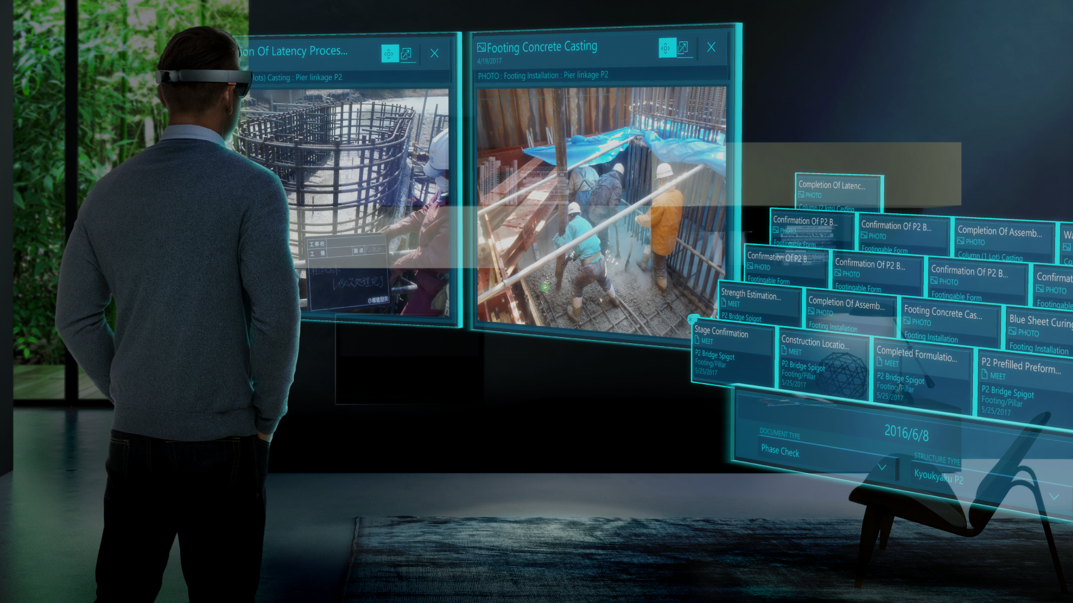
Gaze Tracker
B04901003 許傑盛
B04901059 蔡承佑

Slide 2
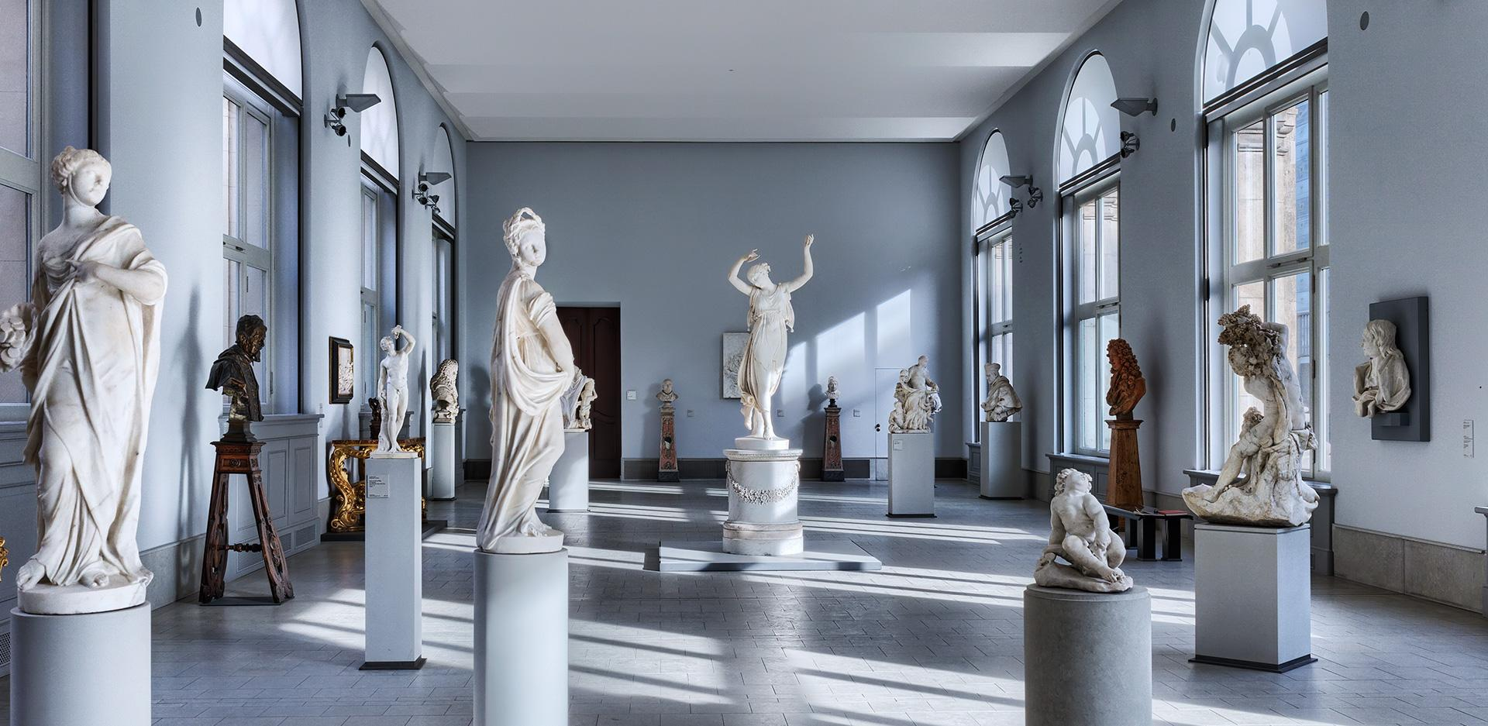

Slide 3
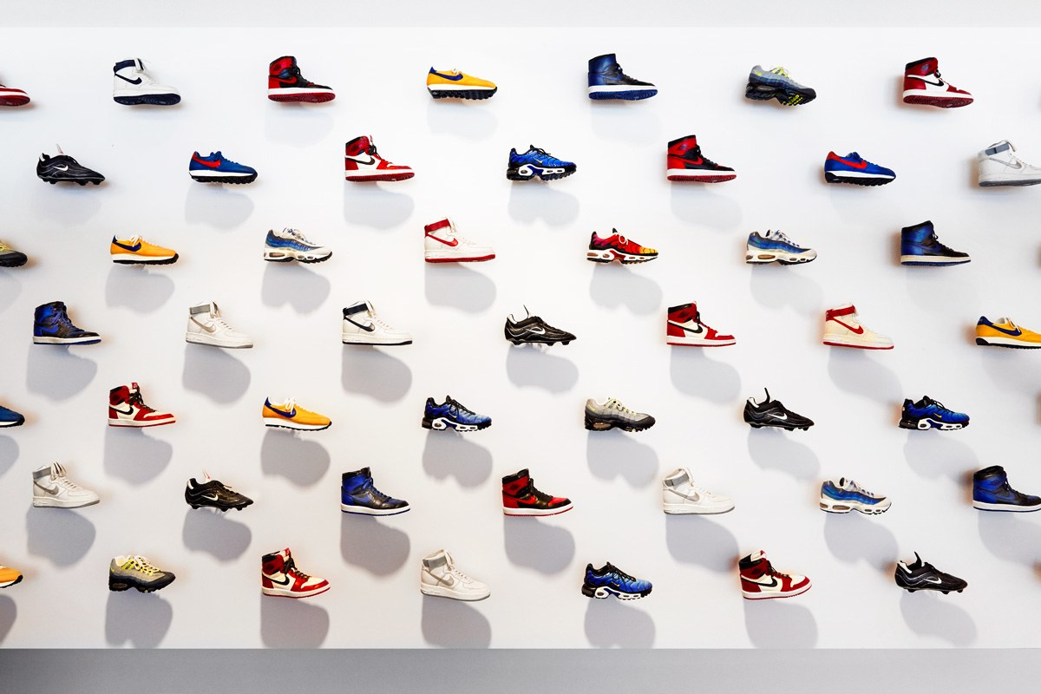


Slide 4
Name: Lawrence with a dress
Year: 1776-1779
Creator: Jason Hsu
Name: Jason Napping
Year: 1861-1862
Creator: Lawrence Tsai

Slide 5

Item:Nike red shoe
Price: NTD 3000
Item:Another Nike red shoe
Price: NTD 200

Slide 6

Video demo

Slide 7
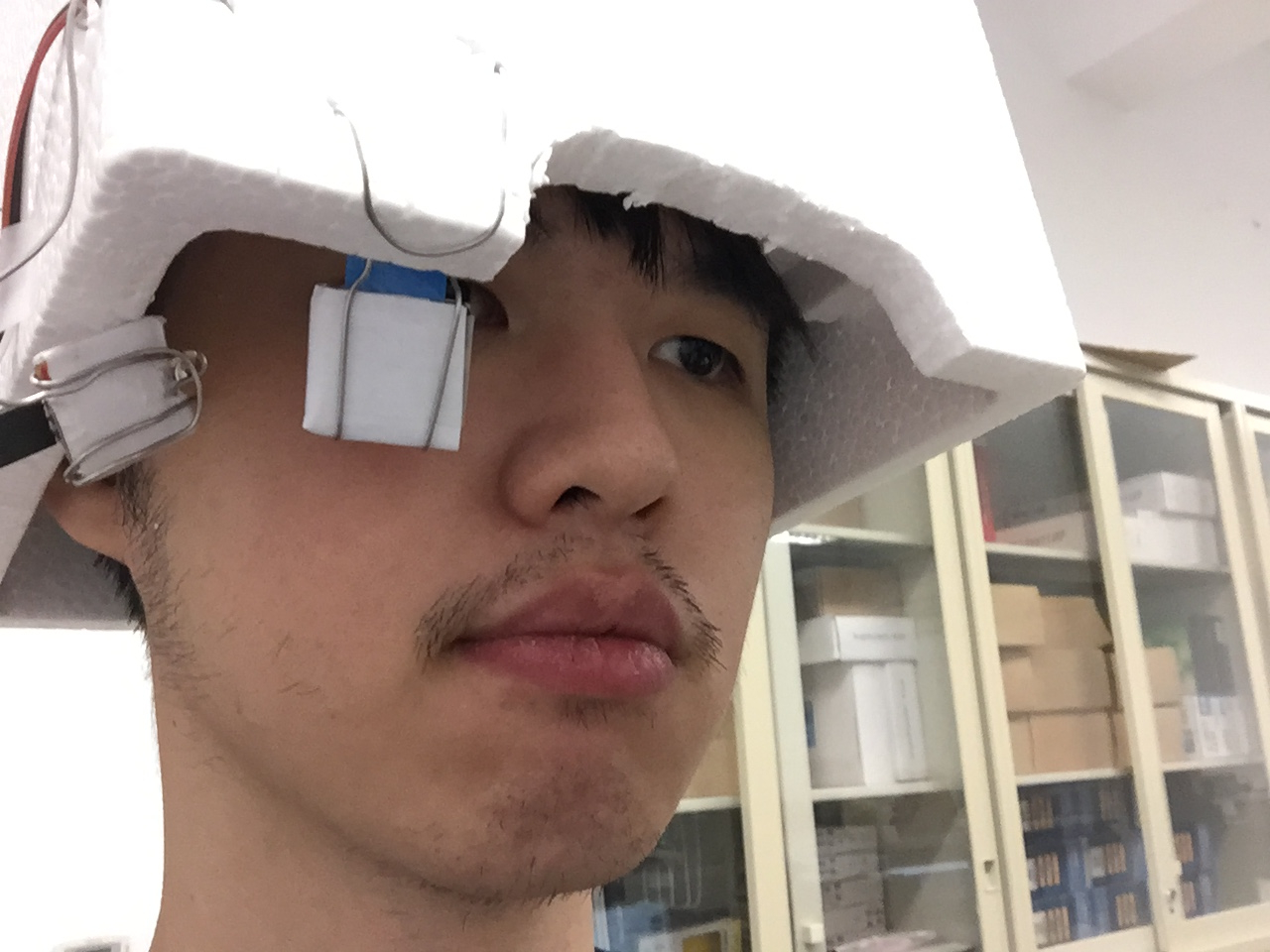
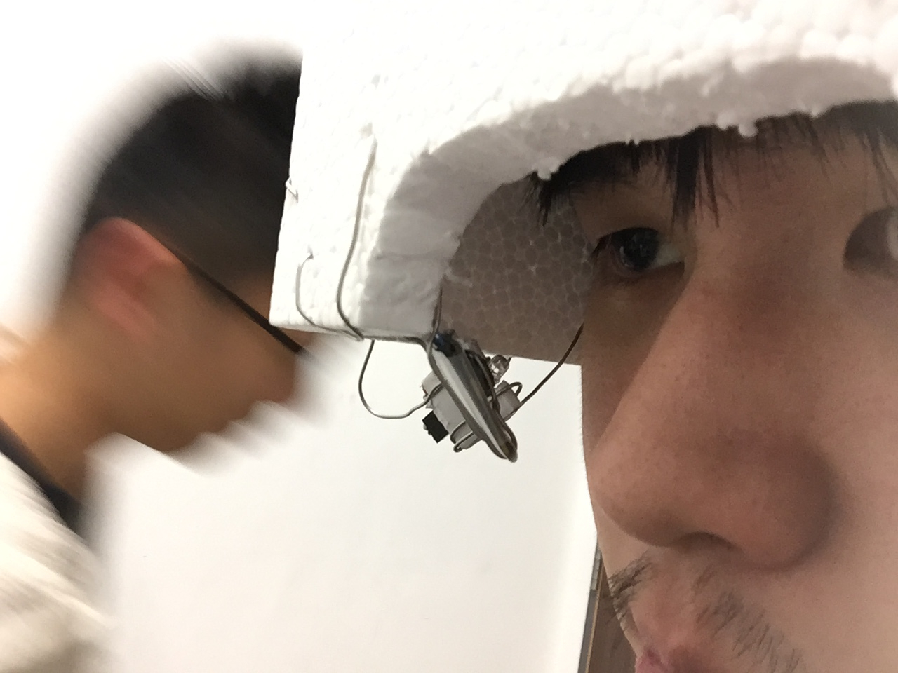

Slide 8
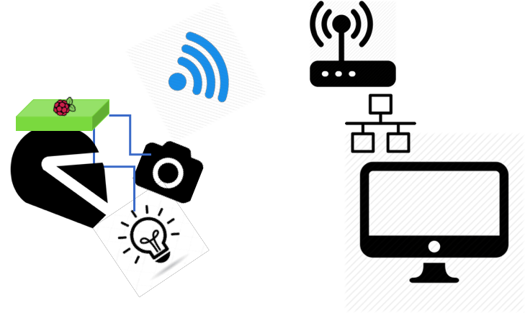

Slide 9
Main Structure
Raspberry Pi:
Manipulate edge device - camera, IR LED
Communication thru internet - raspivid + gstreamer
PC (Ubuntu 16.04):
According to image from camera, calculate the gaze position & correspond target
Show the information of the target where gaze point

Slide 10
Tough things to deal with
Gaze capture
At the very beginning, We found a project from github, however it’s windows base project, we solve all the dependency, libraries, and modify the according cmake files for 3 weeks…
We also spend much time to fine tune the position of camera, IR LED, and some figure in code to optimize the gaze capture process.

Slide 11
REference
YutaItoh 3D-Eye-Tracker https://github.com/YutaItoh/3D-Eye-Tracker
LeszekSwirski singleeyefitte
https://github.com/LeszekSwirski/singleeyefitter

